Slide 1

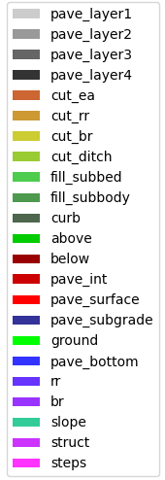
M1.1
M1.1
M2.3
M2.1
M3.1
M3.2
M4.1
M4.1

Slide 2
box_list_MLP_[64,_128,_64,_32]_2_T
box_list_MLP_[128,_64,_32]_1_F
box_list_LSTM_[256,_128,_64]_2_T
box_list_LSTM_[128]_2_F
box_list_transformer_32_0_T
M3. box_list_transformer_64_4_F
M4.
box_list_BERT_2_T
M4.
box_list_BERT_0_F

Slide 3
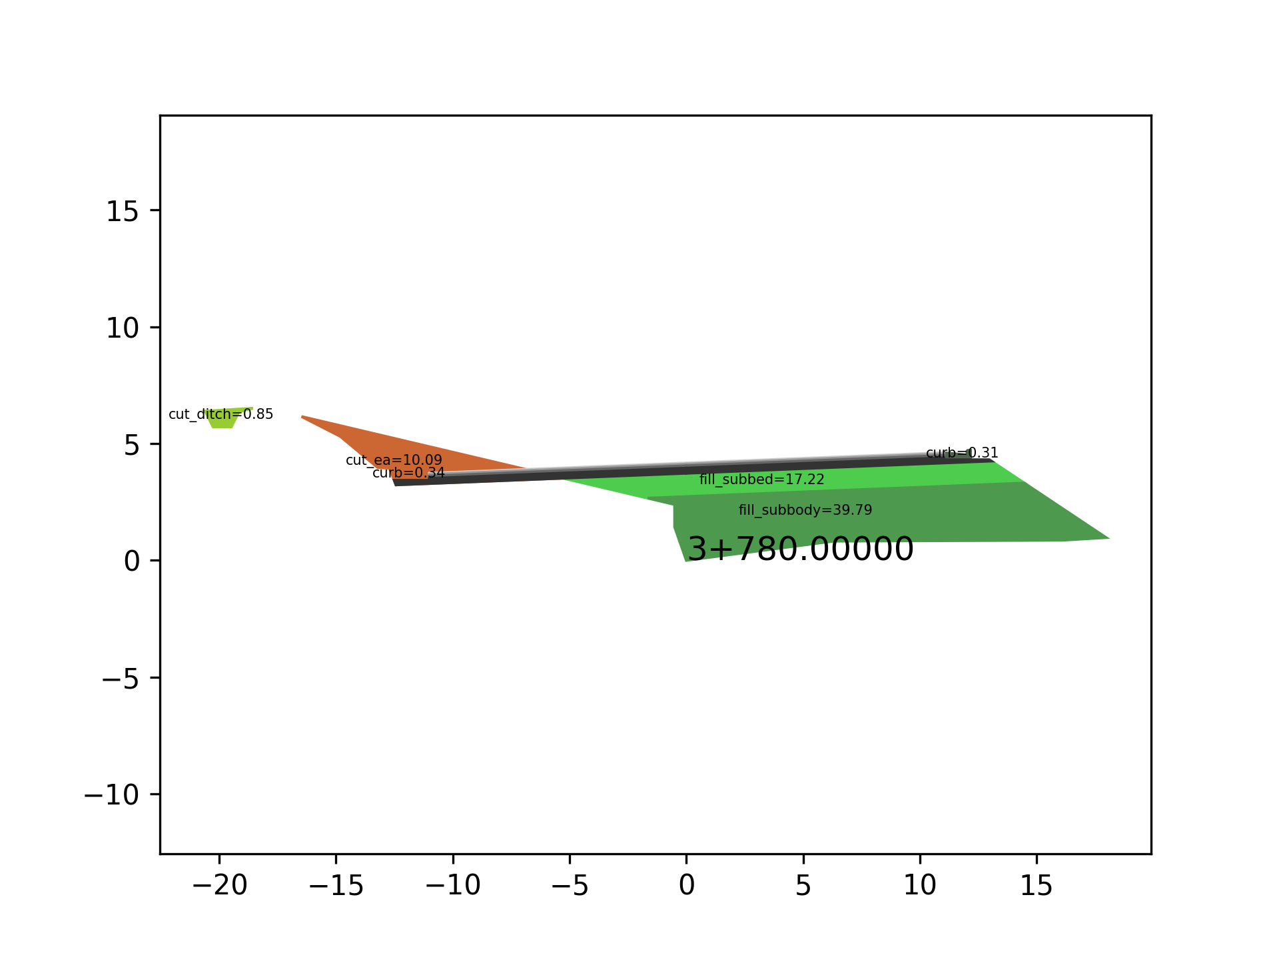
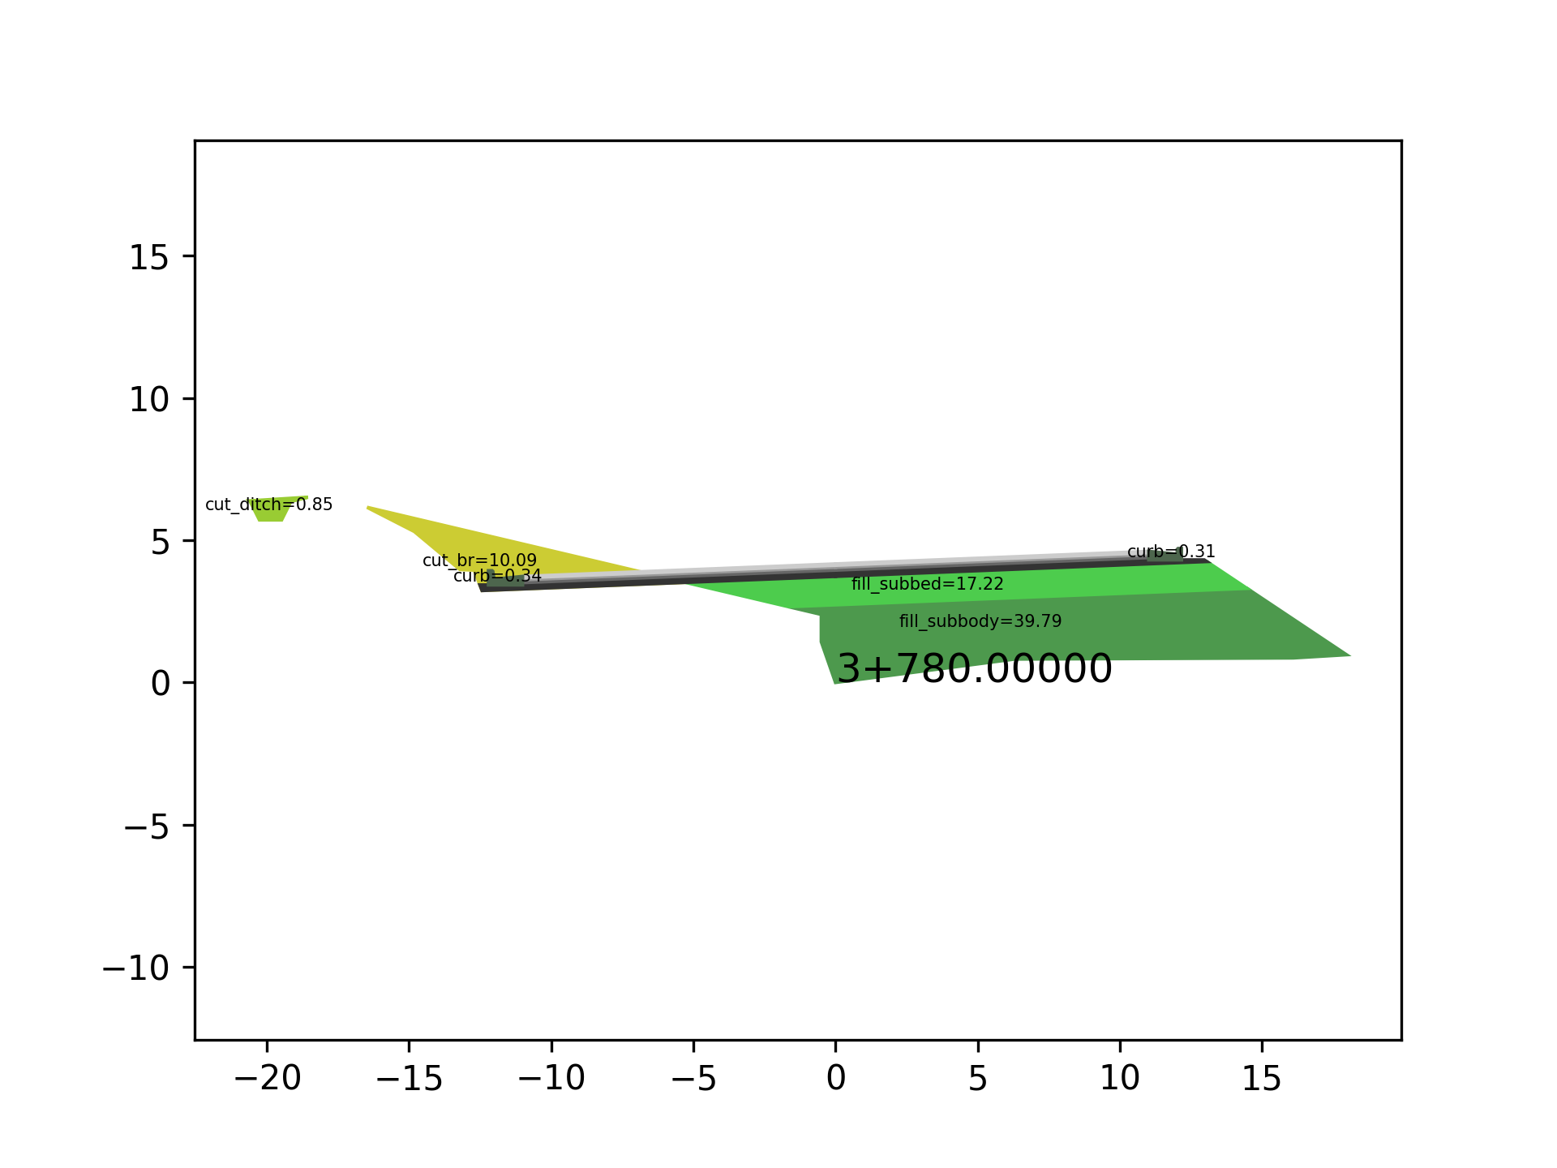
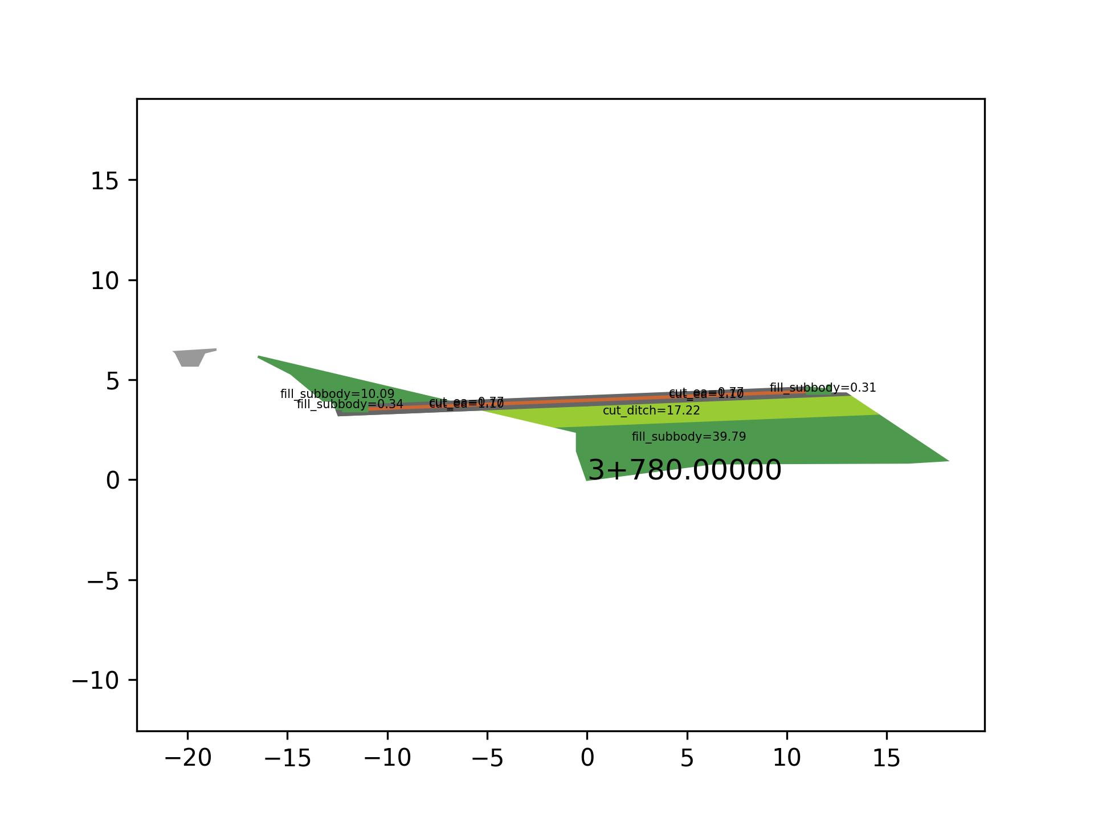
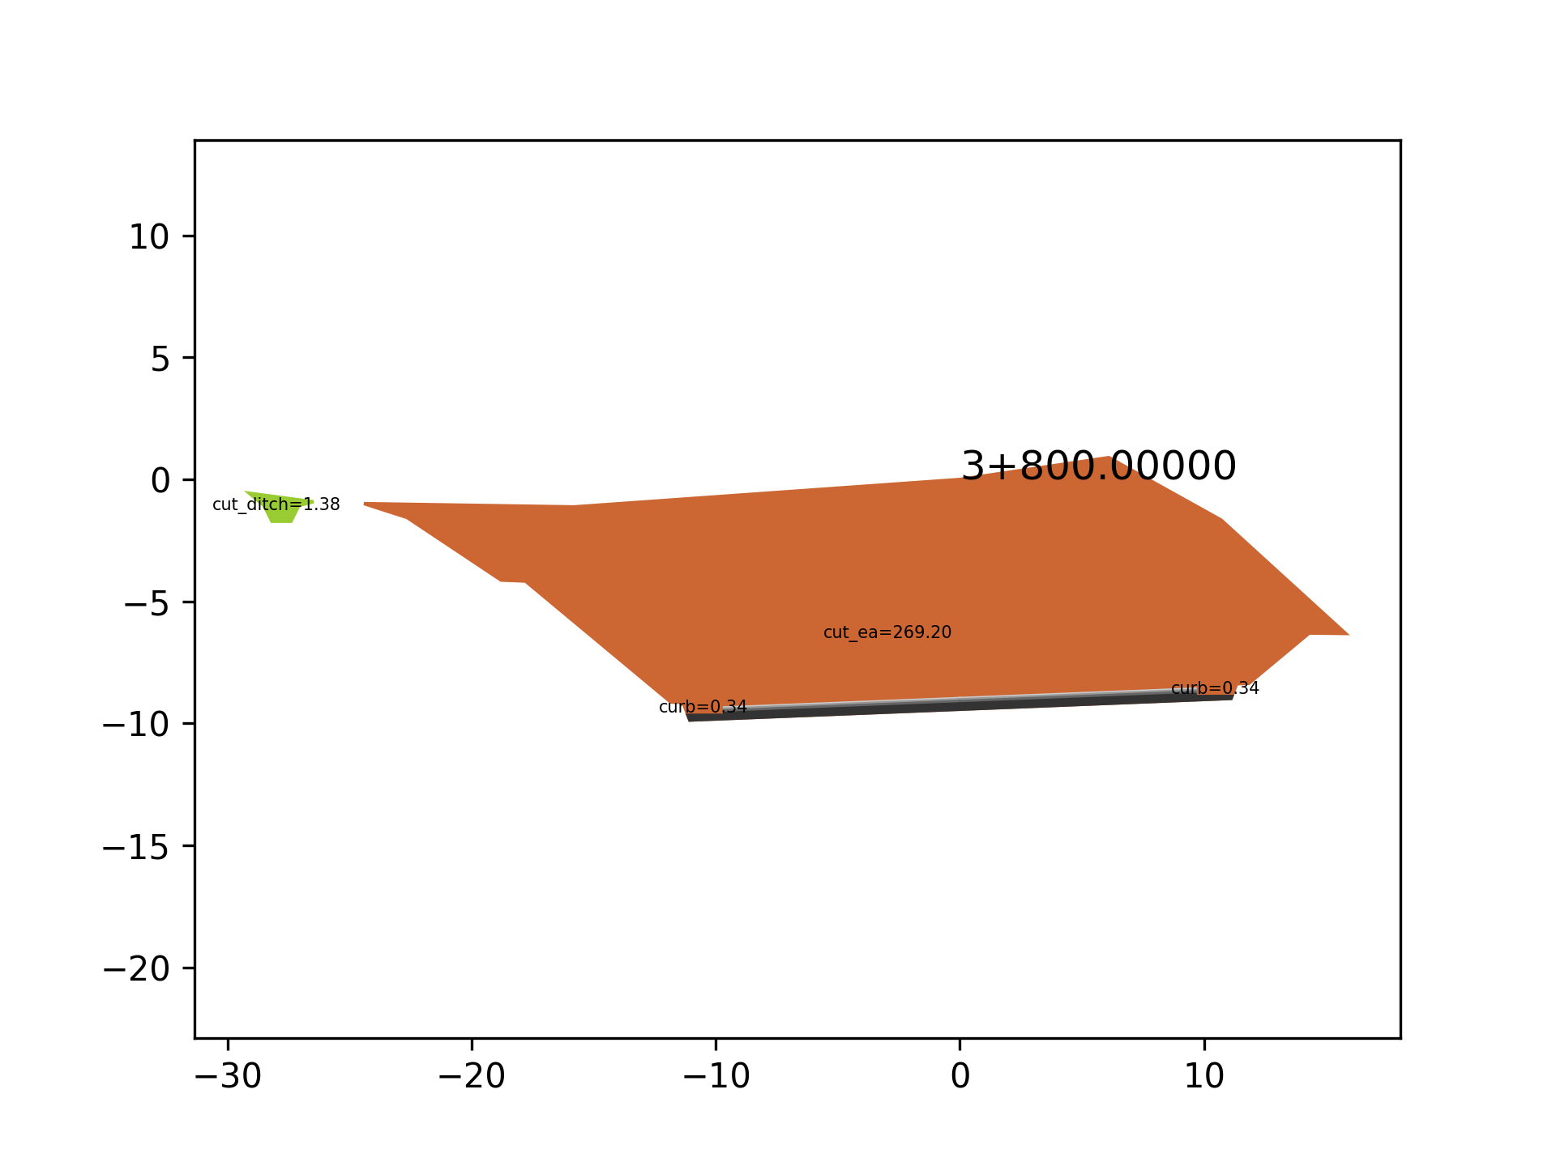
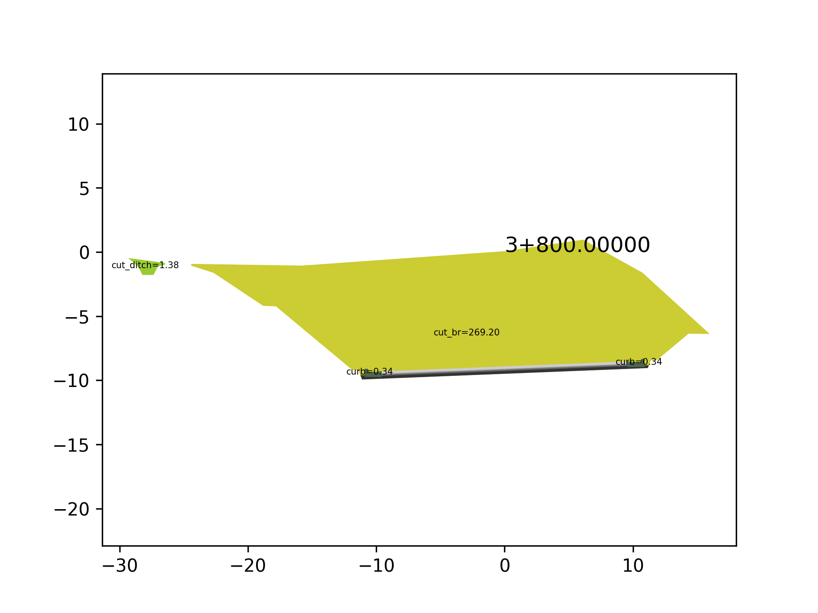
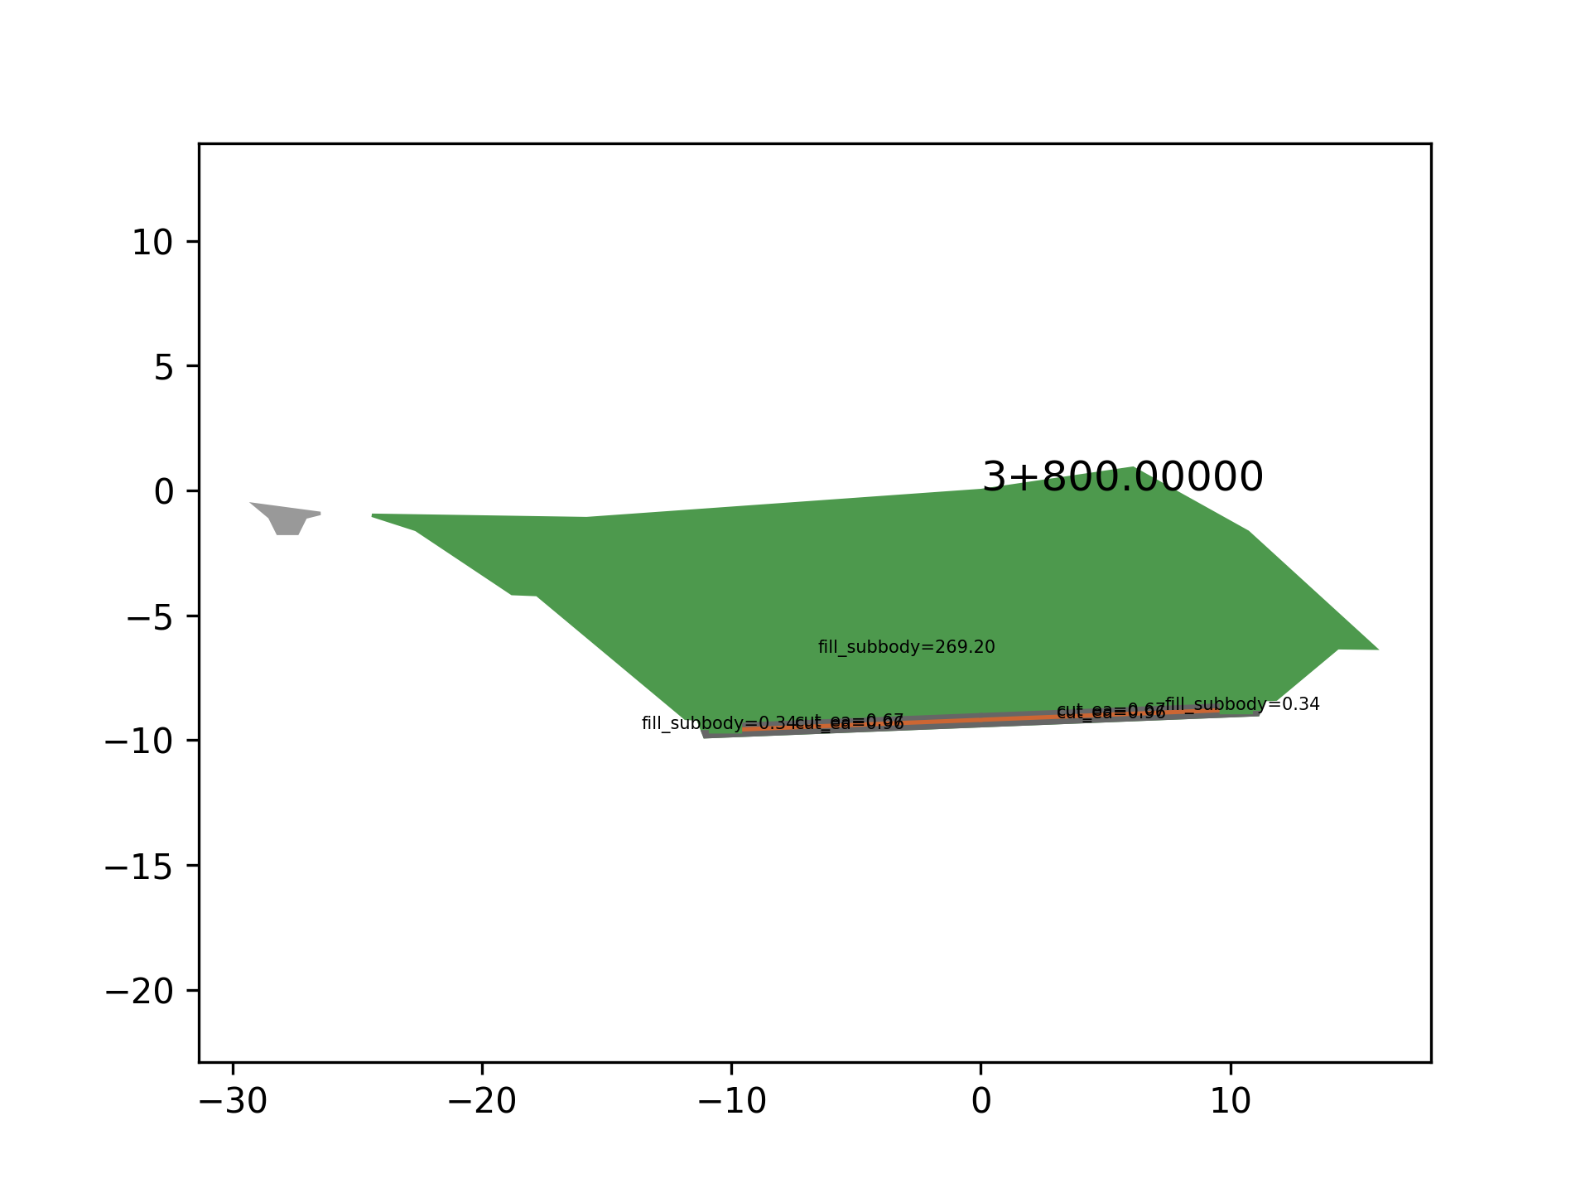
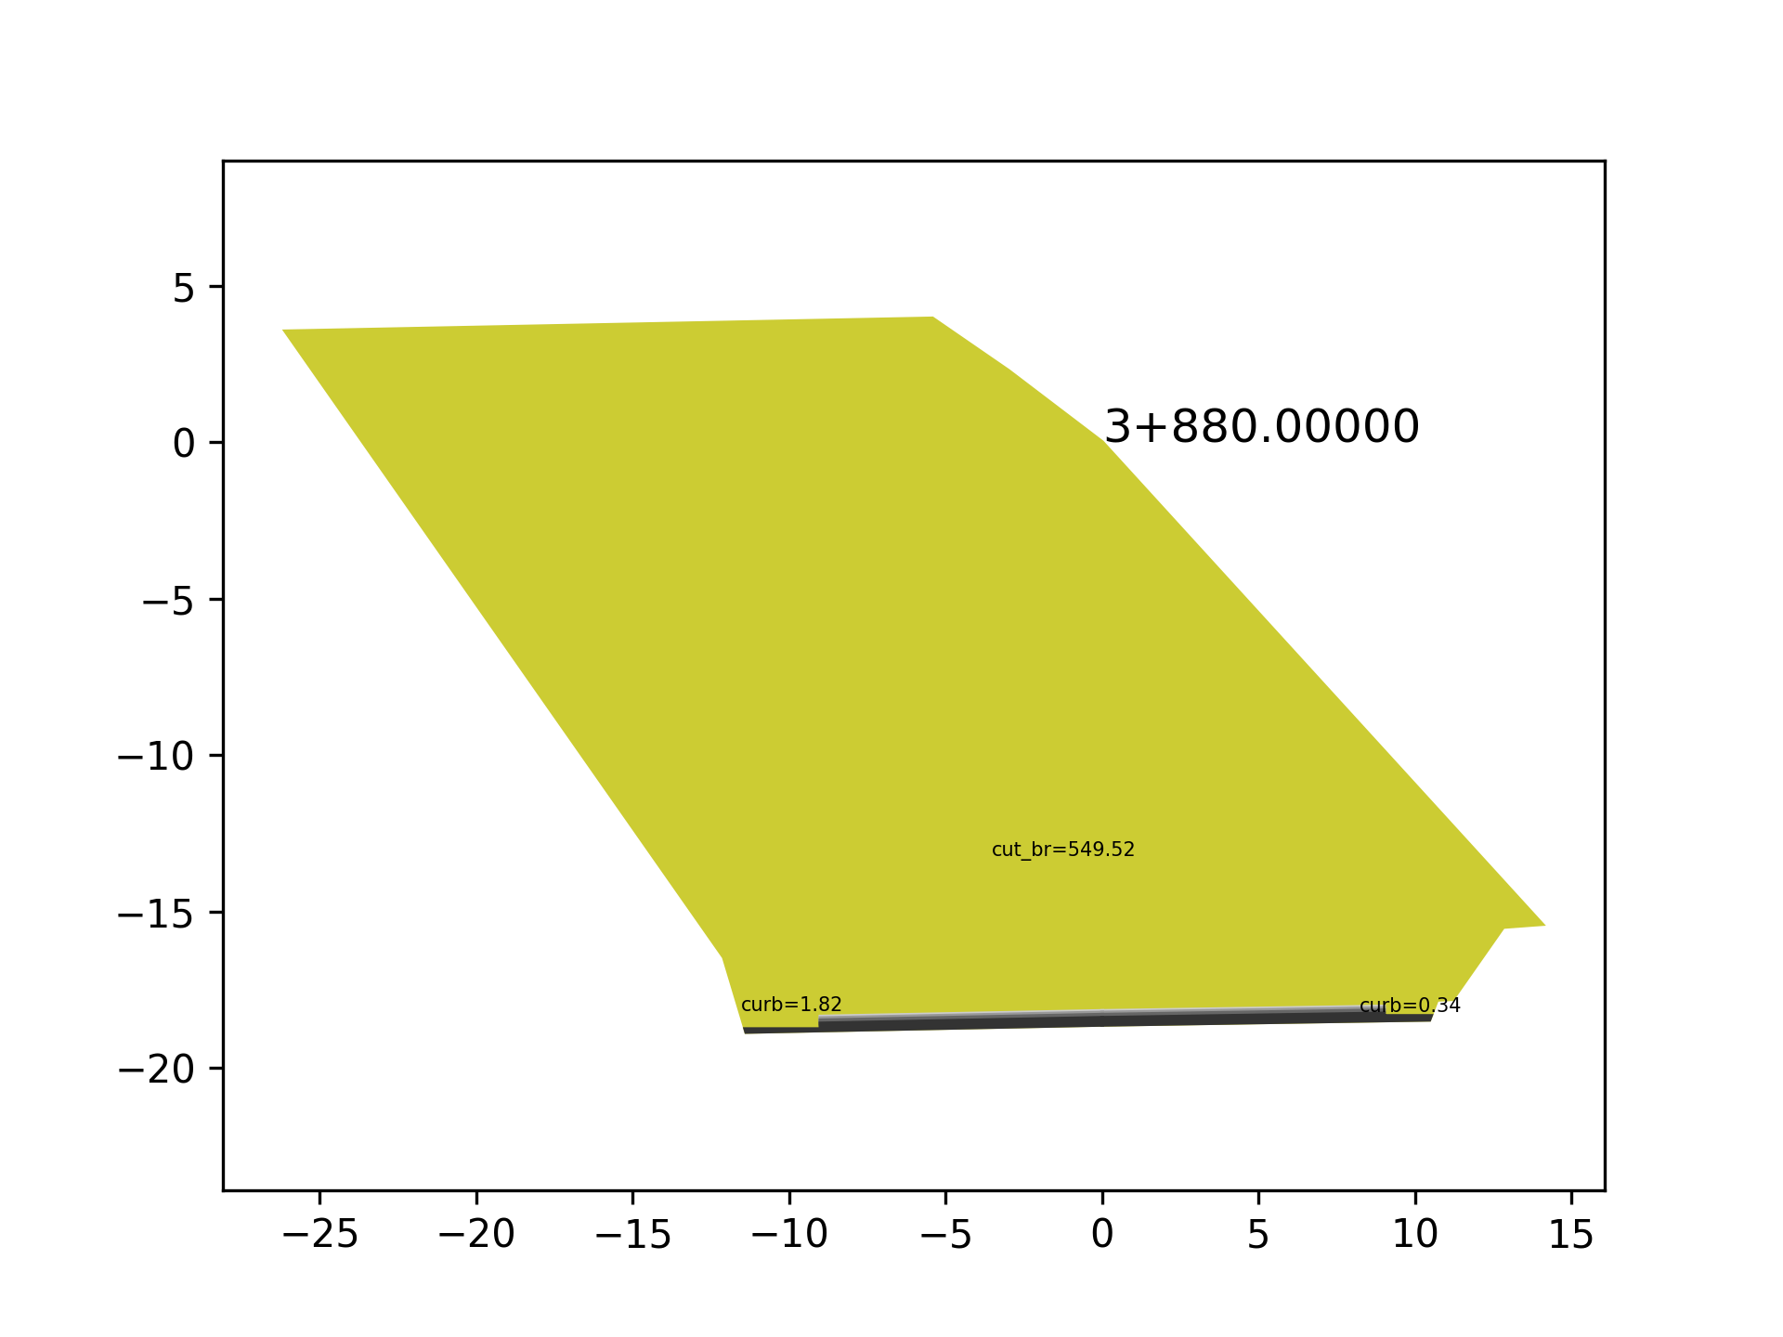
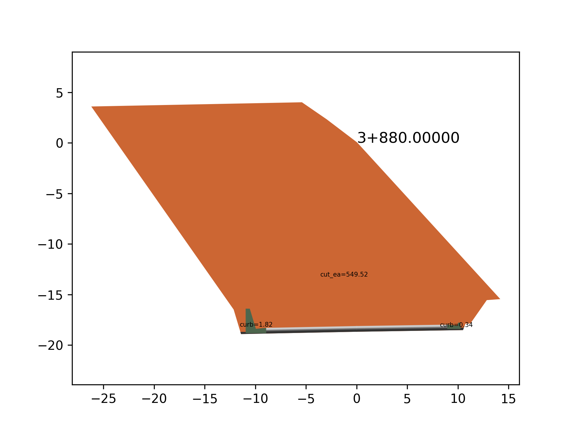
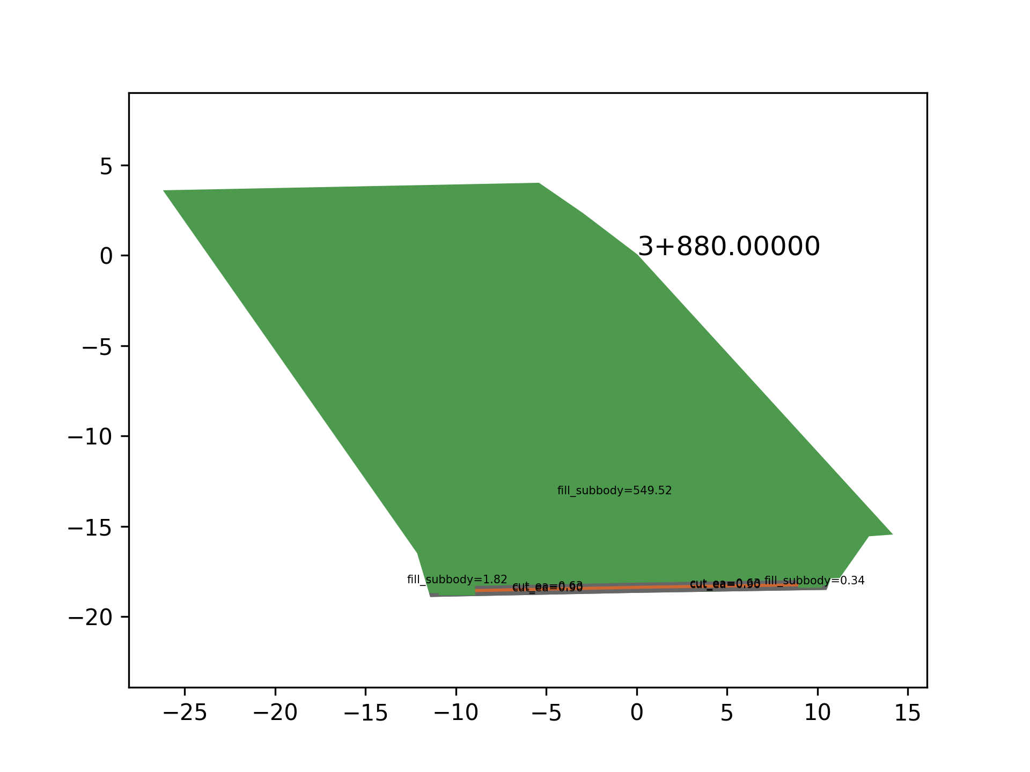
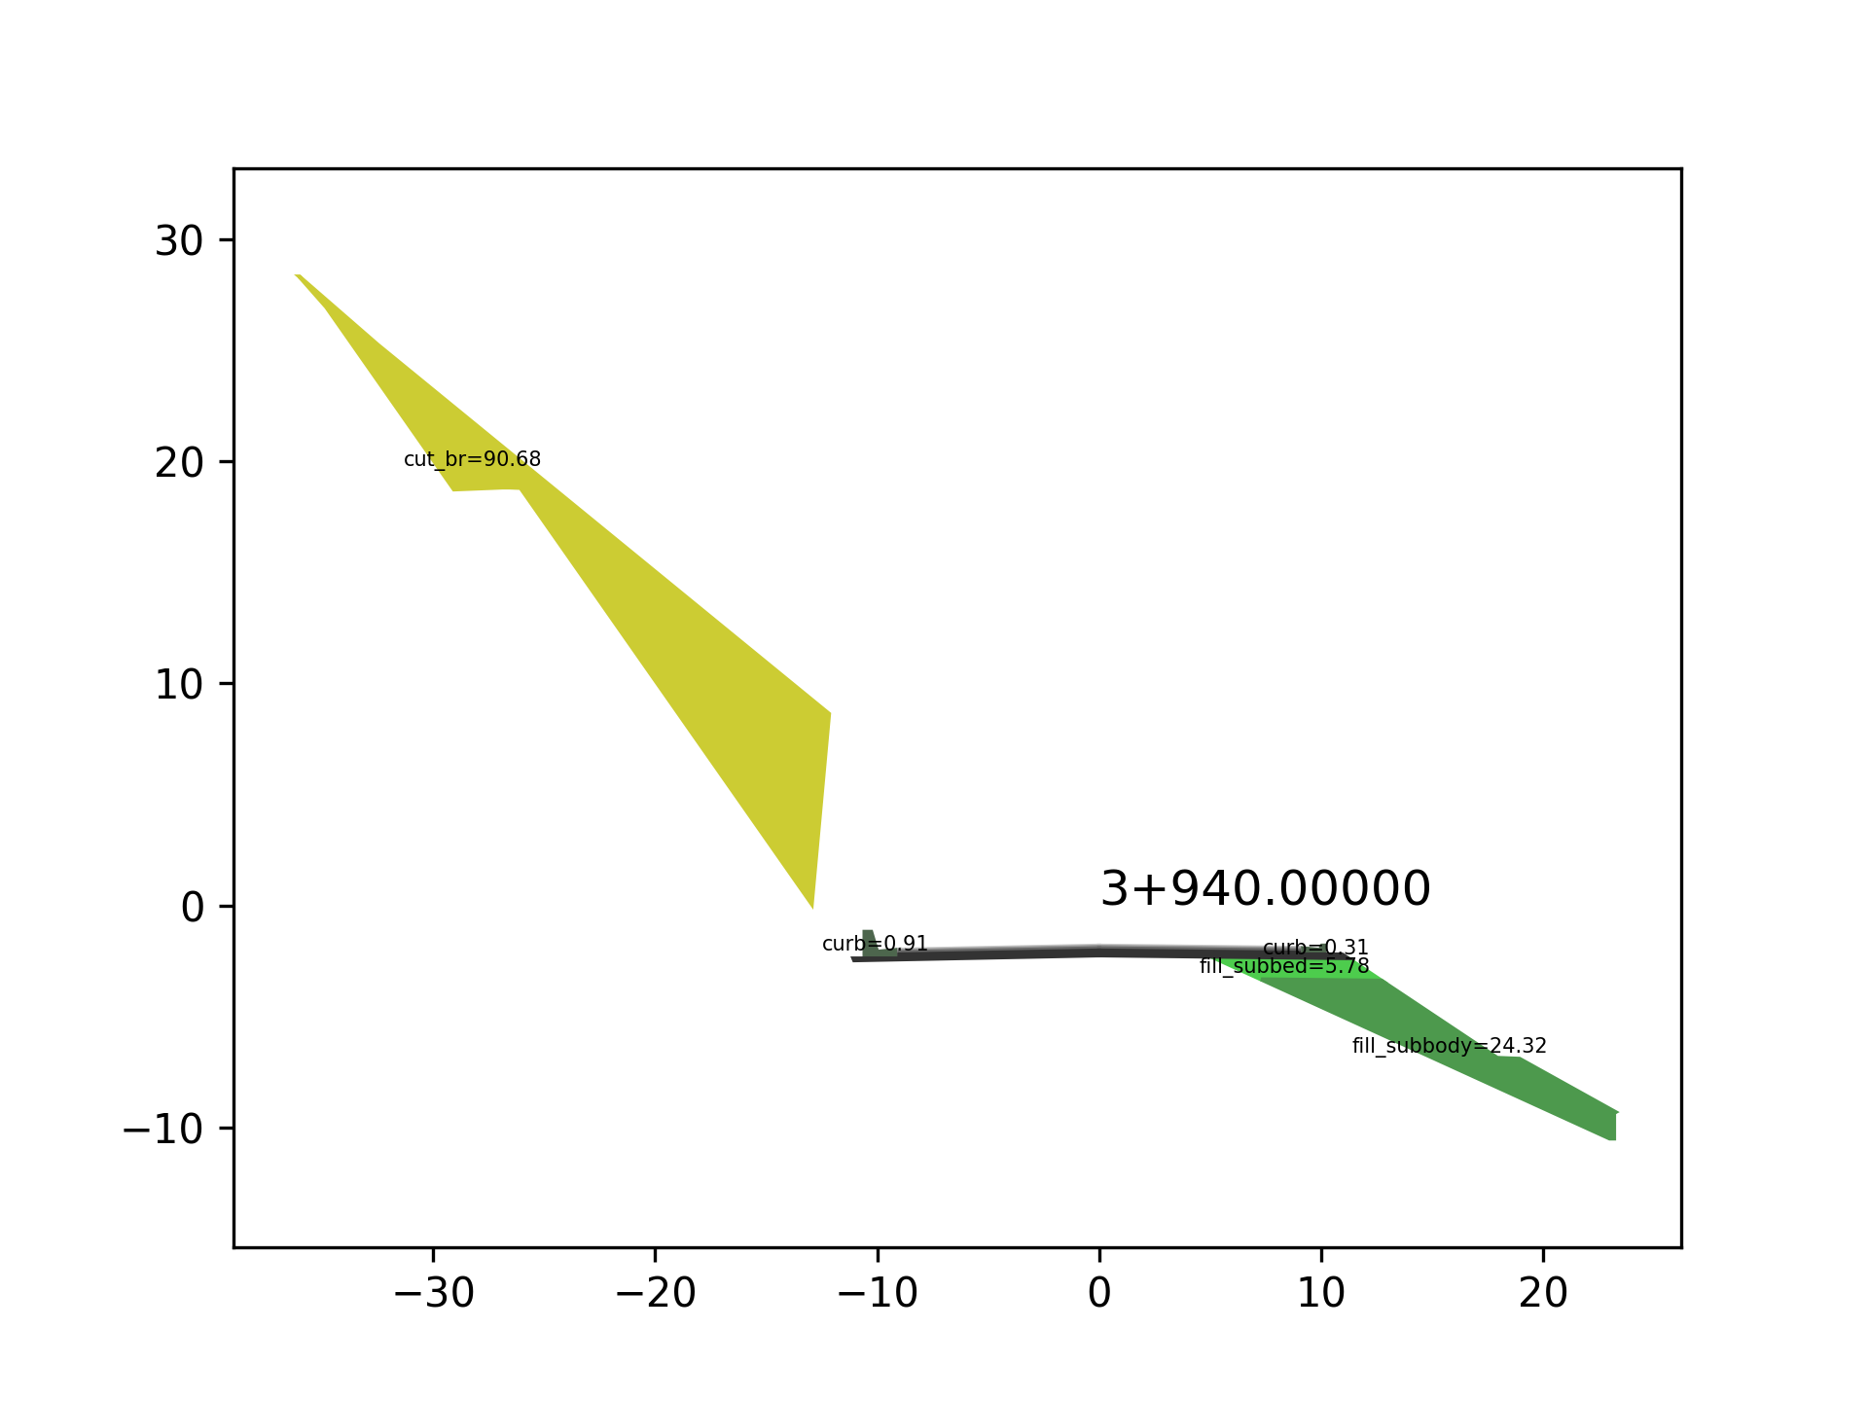
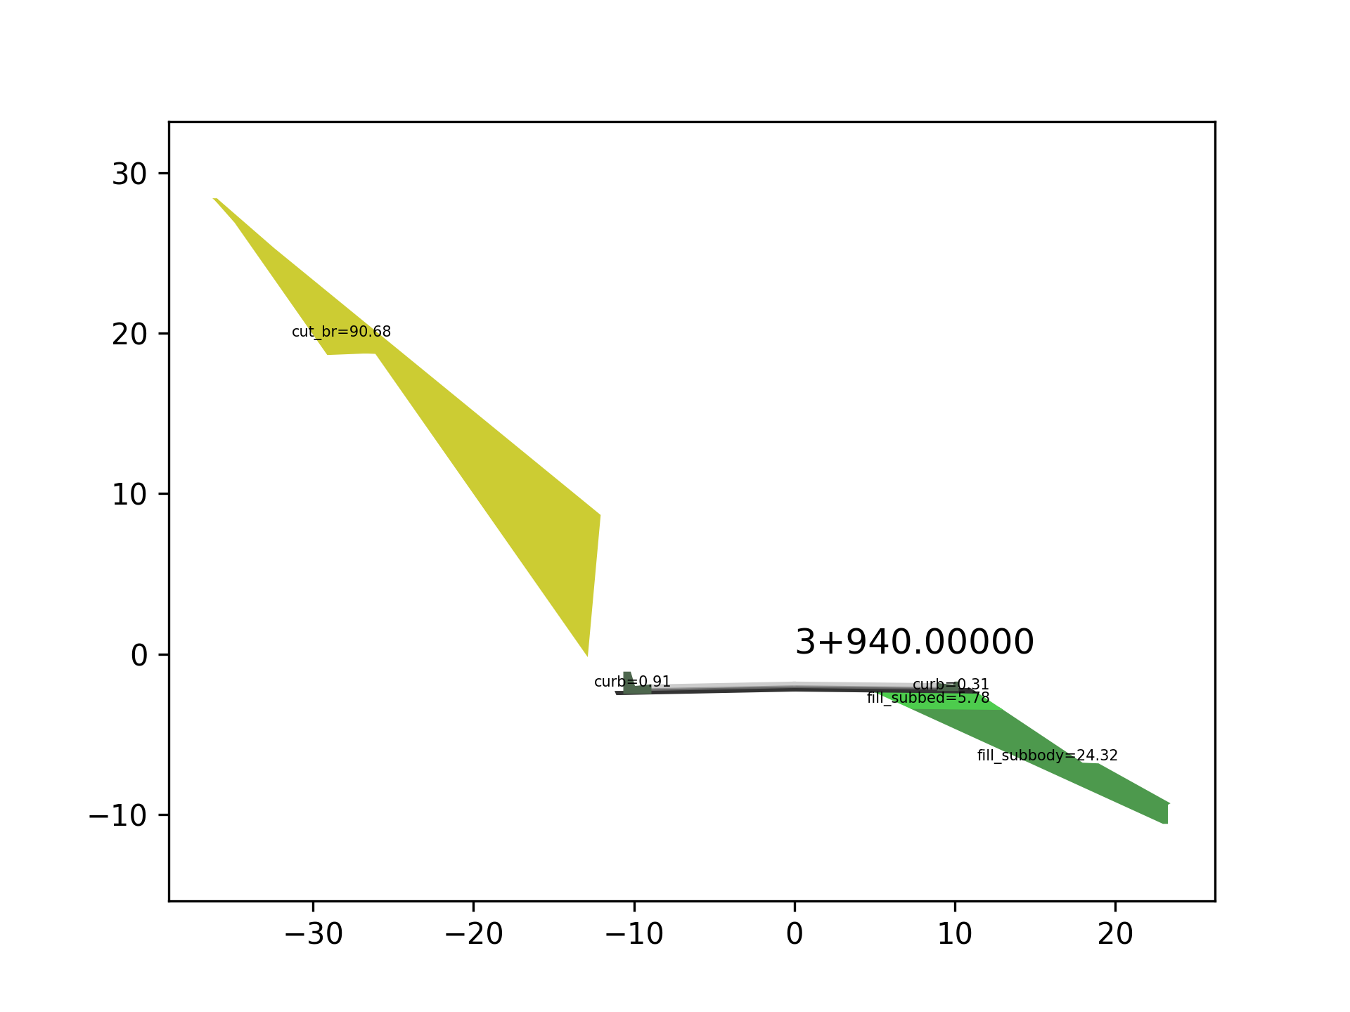
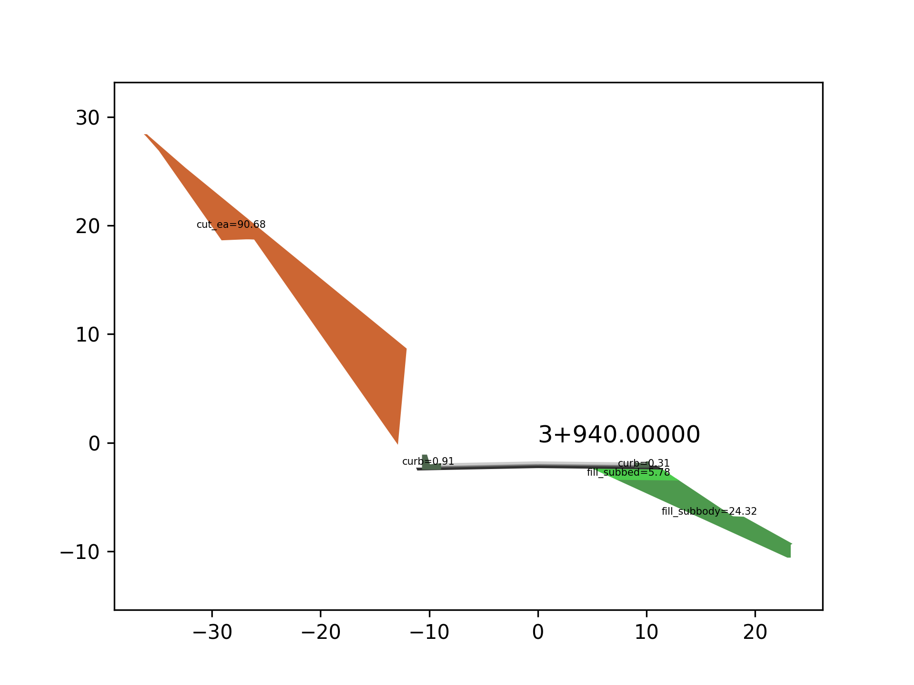
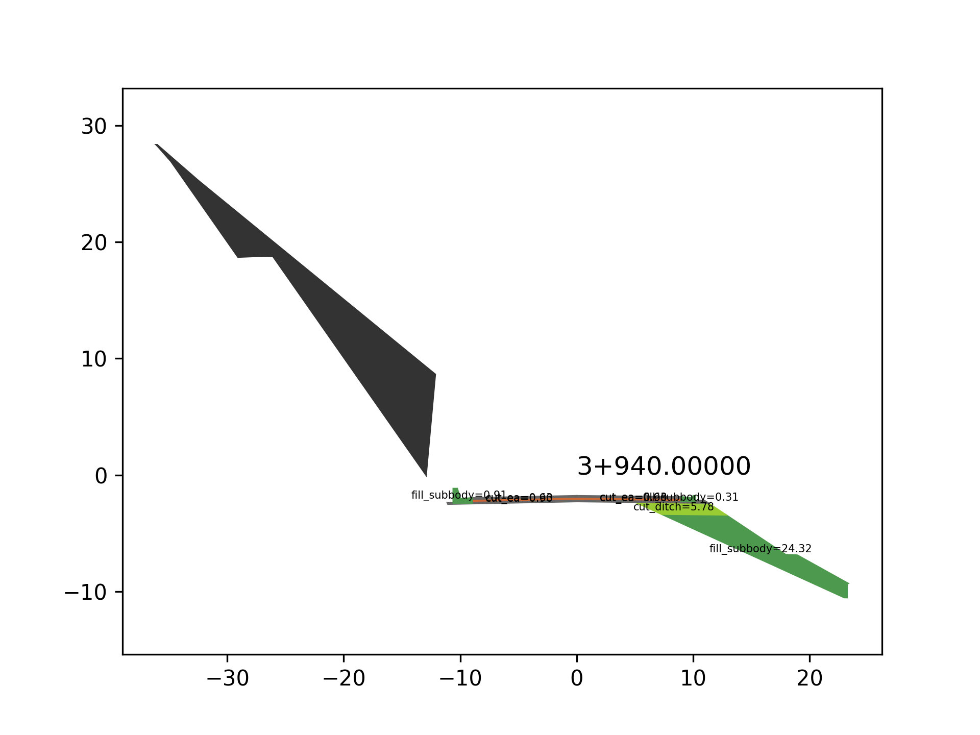
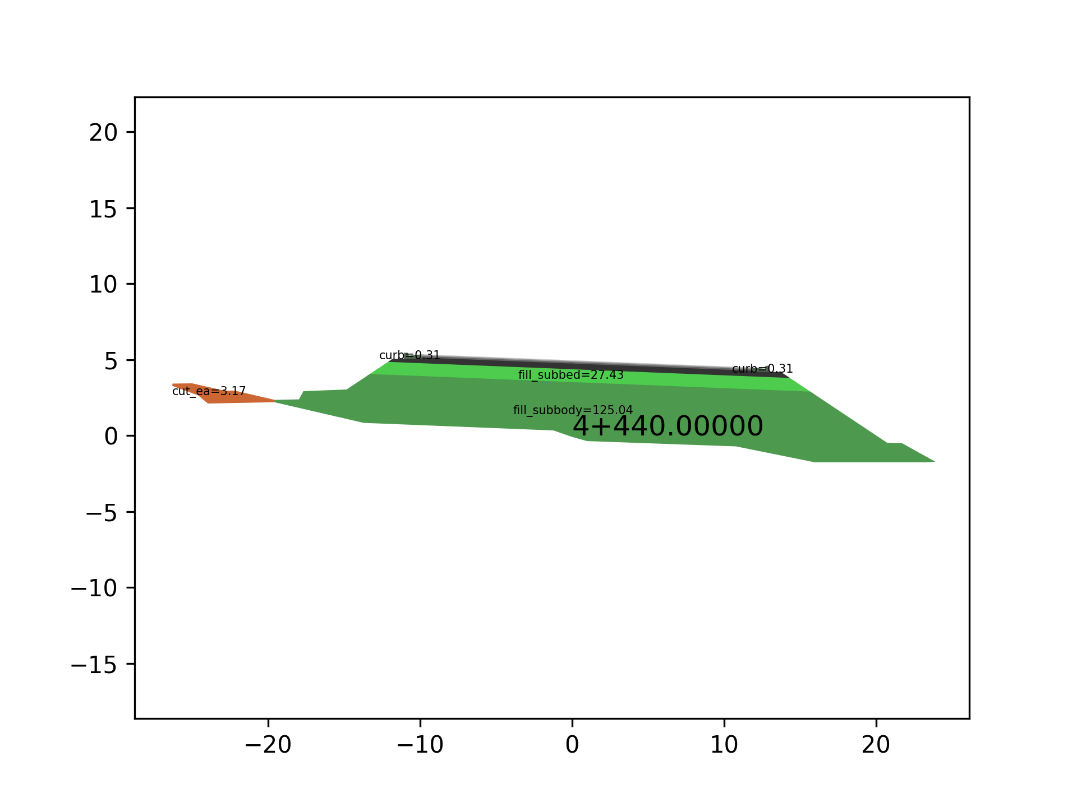
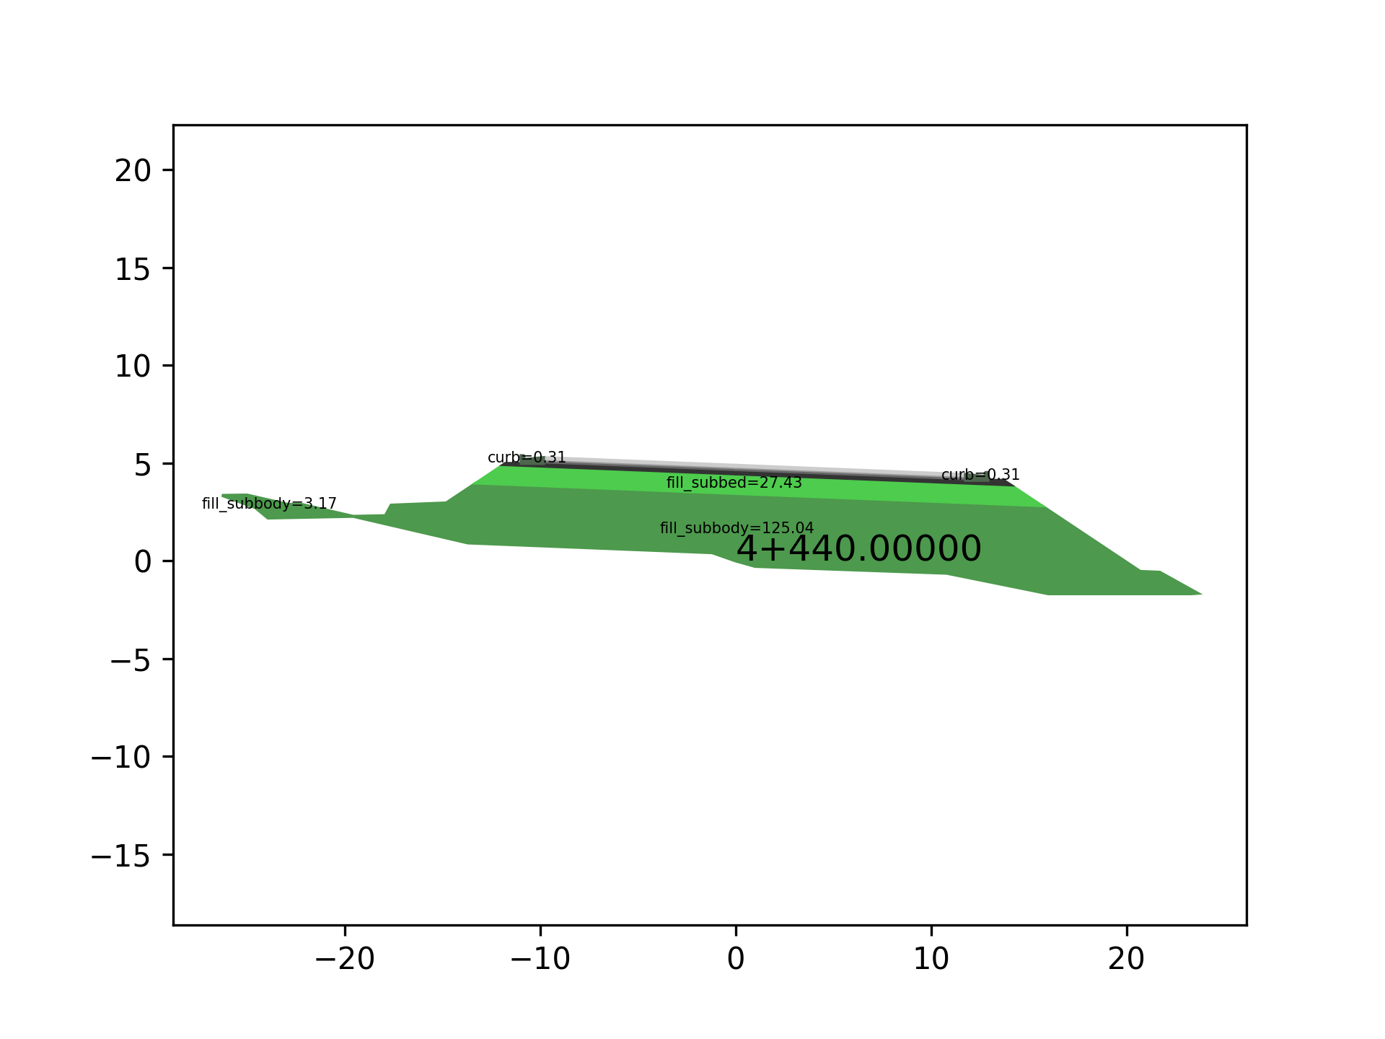
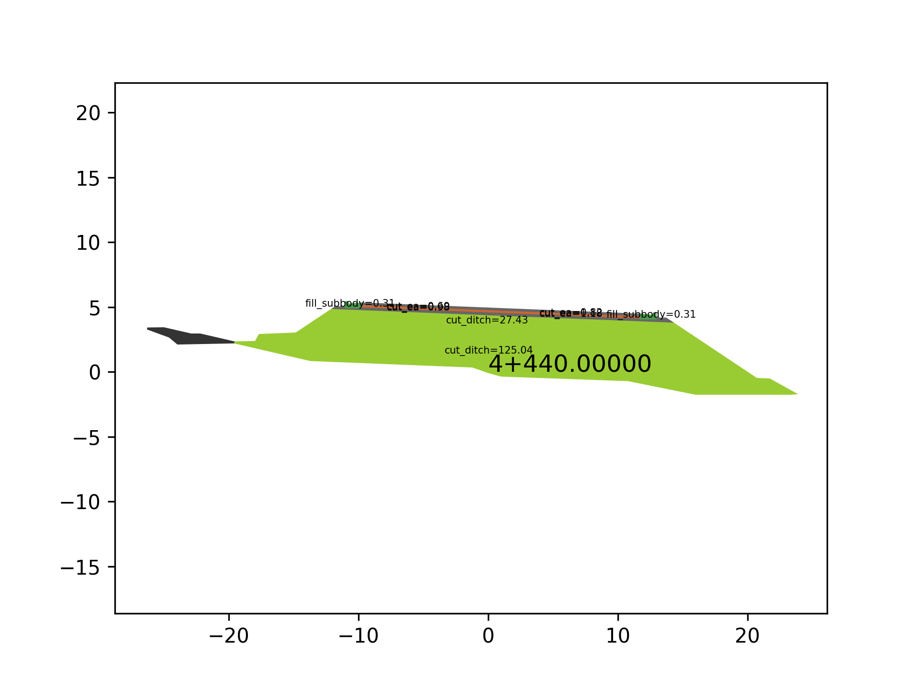
M4.1
M2.2
M1.3
M3.1
3+780.00
3+800.00
3+880.00
3+940.00
4+440.00

Slide 4


