Slide 1
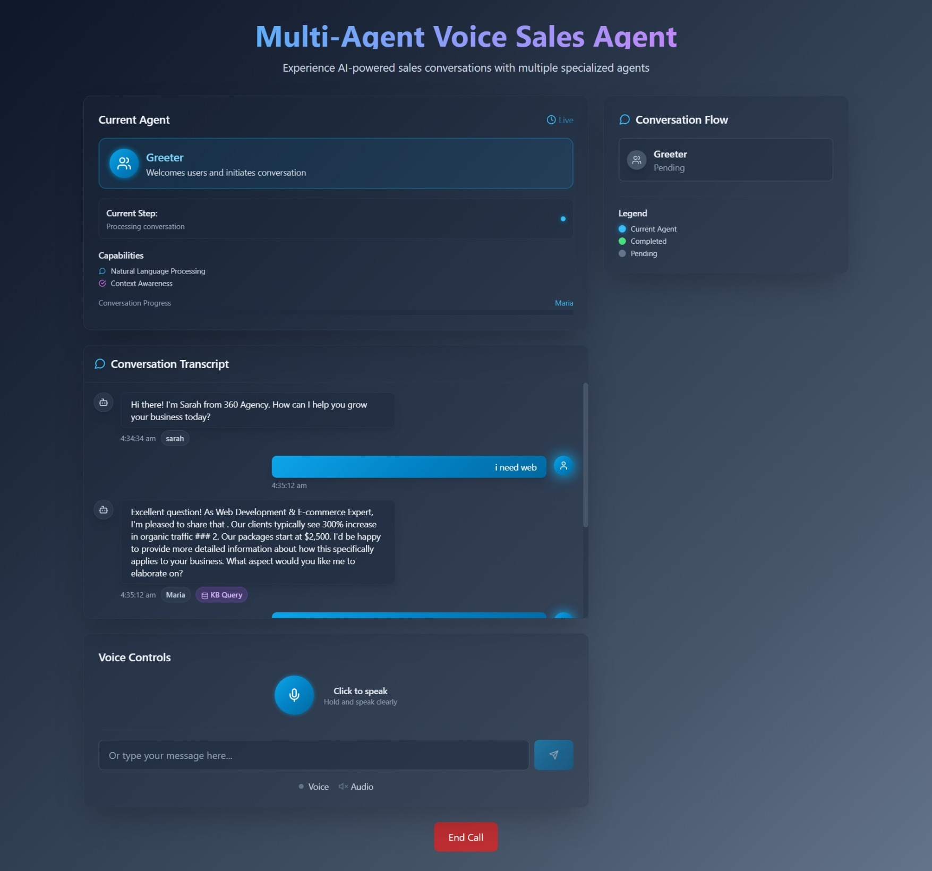
Sale Agent

Slide 2
History of AI
1950s: Early AI research begins.
AI winters and periods of rapid growth.
Modern AI driven by data and compute power.

Slide 3
Key Fields in AI
Machine Learning
Natural Language Processing
Computer Vision and Robotics

Slide 4
Machine Learning Basics
Systems learn patterns from data.
Improves performance over time without explicit programming.
Common in recommendation systems and prediction models.

Slide 5
Types of Machine Learning
Supervised Learning
Unsupervised Learning
Reinforcement Learning

Slide 6
Supervised Learning
Uses labeled data.
Learns mapping from inputs to outputs.
Used for classification and regression tasks.

Slide 7
Unsupervised Learning
Works with unlabeled data.
Finds patterns and structure in data.
Used for clustering and dimensionality reduction.

Slide 8
Reinforcement Learning
Agent learns by interacting with an environment.
Receives rewards or penalties for actions.
Used in games and robotics.

Slide 9
Deep Learning
Subset of machine learning using neural networks.
Excels at image, audio, and language tasks.
Requires large datasets and computing power.

Slide 10
Neural Networks
Inspired by the human brain.
Layers of interconnected nodes (neurons).
Learn to approximate complex functions.

